Slide 1
Leakage Pathway through Wellbore

Slide 2
ROMs Design
Input Parameters | Values Ranges
Aquifer Depth (Daq) | 3000 – 9000 (ft)
Reservoir Depth (Dres) | 200 – 2000 (ft)
Reservoir Pressure Multiplier (P) | 1.0 – 1.2 (/)
Wellbore Permeability (Kwb) | 0.01 – 1000 (mD)
Porosity (φ) | 0.09 – 0.33 (/)
Water Saturation (Sw) | 0.15 – 0.5 (/)
Z_H2 | 0.1 – 0.65 (/)
Z_C1 | 0.1 – 0.35 (/)
Z_C4 | 0.01 – 0.1 (/)
Z_C7+ | 0.03 – 0.75 (/)
Reservoir Volume Ratio | 1, 10, 100
Aquifer ( 1 grid cell)
Output Parameters
Mole fraction of hydrogen components in liquid phase (XMF_1)
Mole fraction of hydrogen components in gas phase (YMF_1)
Mole fraction of C1 components in liquid phase (XMF_2)
Mole fraction of C1 components in gas phase (YMF_2)
Mole fraction of C4 components in liquid phase (XMF_3)
Mole fraction of C4 components in gas phase (YMF_3)
Mole fraction of C7+ components in liquid phase (XMF_4)
Mole fraction of C7+ components in gas phase (YMF_4)
Oil in place mass (OIPM)
Gas in place mass (GIPM)
Caprock ( 500 grid cells)
Reservoir ( 1 grid cell)
Simulation time = 1000 years (10 years step)

Slide 3

CNN model for Classification
Results:
3000 Sample
Data Shape (3000, 101, 9)
loss: 0.0024
accuracy: 0.9987

Slide 4
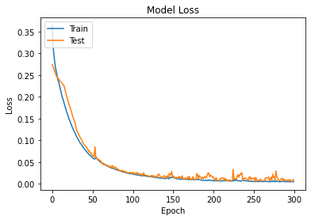
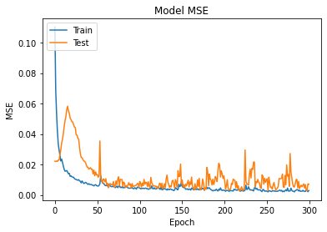
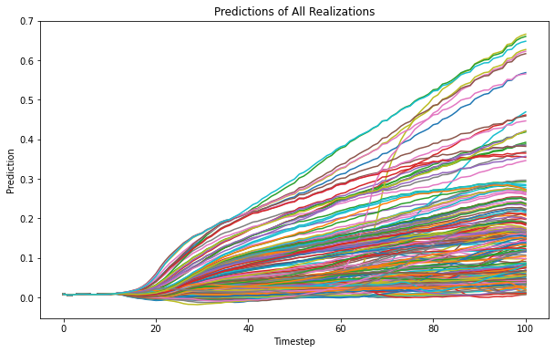
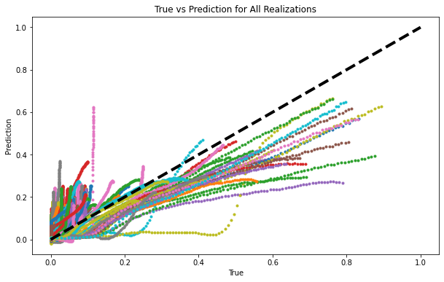
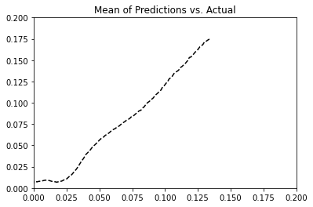
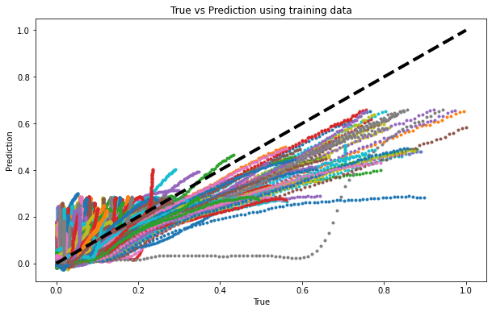
LSTM Models for Regression (Fully LSTM)
1)
64
256
64
8
1
9
16
m
16
m
Layer 1:
LSTM (9)
L2(5e-5)
dropout=0.1
PReLU
BatchNorm
Layer 2:
LSTM (16)
L2(5e-4)
dropout=0.1
PReLU
BatchNorm
Layer 3:
LSTM (64)
L2(5e-4)
dropout=0.1
PReLU
BatchNorm
Layer 4:
LSTM (256)
L2(5e-4)
dropout=0.1
PReLU
BatchNorm
Layer 5:
LSTM (64)
L2(5e-4)
dropout=0.1
PReLU
BatchNorm
Layer 6:
LSTM (16)
L2(5e-4)
dropout=0.1
PReLU
BatchNorm
Layer 7:
LSTM (8)
L2(5e-4)
dropout=0.1
PReLU
BatchNorm
Layer 8:
LSTM (1)
L2(5e-5)
dropout=0.1
BatchNorm
Model Compilation and Fit:
Optimizer: Nadam
Learning Rate: 0.001
Loss:’mse’
Epochs: 300
Batch Size: 75
Validation Split: 0.2
shuffle=True
verbose=True

Slide 5
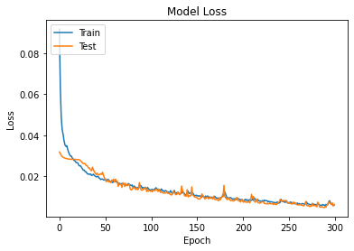
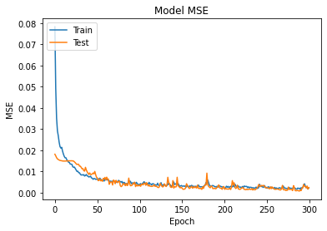
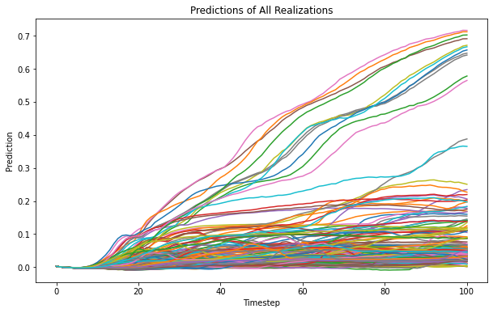
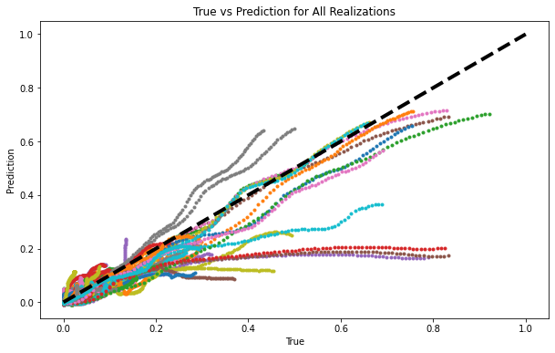
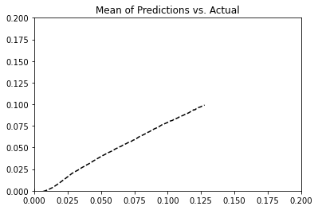
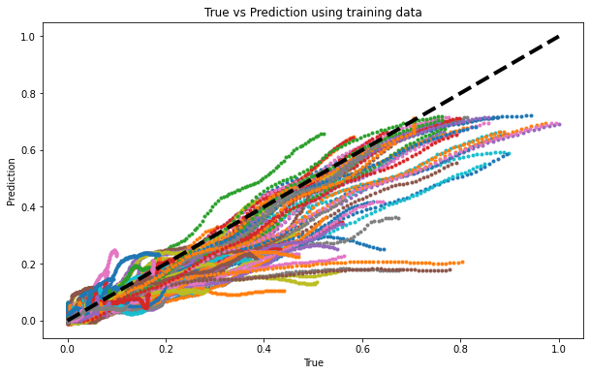
LSTM Models for Regression (Fully LSTM)
2)
32
64
32
8
1
9
16
m
16
m
Layer 1:
LSTM (9)
L2(5e-5)
dropout=0.1
PReLU
BatchNorm
Layer 2:
LSTM (16)
L2(5e-5)
dropout=0.1
PReLU
BatchNorm
Layer 3:
LSTM (32)
L2(5e-5)
dropout=0.1
PReLU
BatchNorm
Layer 4:
LSTM (64)
L2(5e-5)
dropout=0.1
PReLU
BatchNorm
Layer 5:
LSTM (32)
L2(5e-5)
dropout=0.1
PReLU
BatchNorm
Layer 6:
LSTM (16)
L2(5e-5)
dropout=0.1
PReLU
BatchNorm
Layer 7:
LSTM (8)
L2(5e-5)
dropout=0.1
PReLU
BatchNorm
Layer 8:
LSTM (1)
L2(5e-5)
dropout=0.1
BatchNorm
Model Compilation and Fit:
Optimizer: Nadam
Learning Rate: 0.001
Loss:’mse’
Epochs: 300
Batch Size: 75
Validation Split: 0.2
shuffle=True
verbose=True

Slide 6
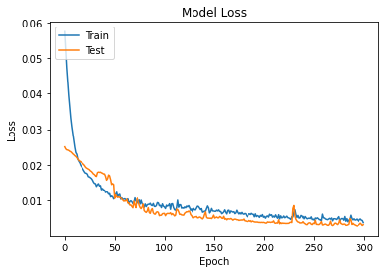
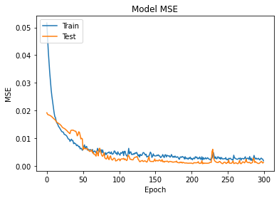
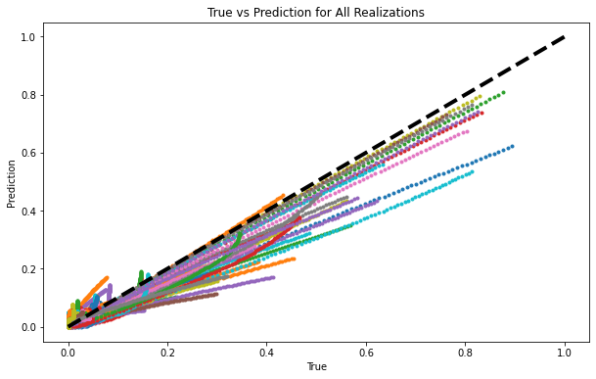
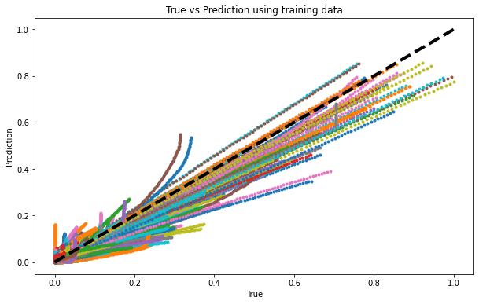
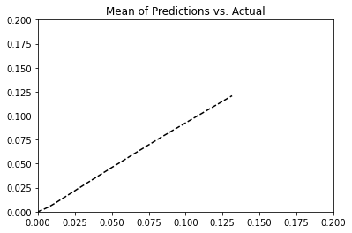
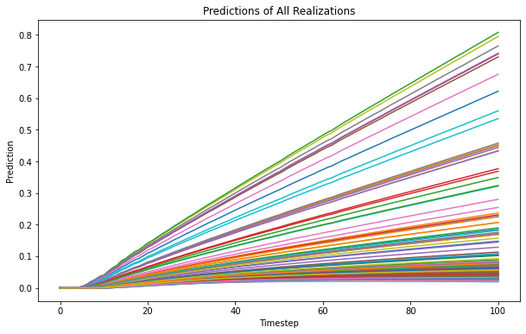
LSTM Models for Regression (LSTM-Dense Layers)
1)
Dense Layers
32
32
16
1
9
16
m
2
Layer 1:
LSTM (9)
L2(5e-5)
dropout=0.1
PReLU
BatchNorm
Layer 2:
LSTM (16)
L2(5e-5)
dropout=0.1
PReLU
BatchNorm
Layer 3:
LSTM (32)
L2(5e-5)
dropout=0.1
PReLU
BatchNorm
Layer 4:
Dense (32)
L2(5e-5)
dropout=0.1
PReLU
BatchNorm
Layer 5:
Dense (16)
L2(5e-5)
dropout=0.1
PReLU
BatchNorm
Layer 6:
Dense (2)
L2(5e-5)
dropout=0.1
PReLU
BatchNorm
Layer 7:
Dense (1)
L2(5e-5)
dropout=0.1
Model Compilation and Fit:
Optimizer: Nadam
Learning Rate: 0.001
Loss:’mse’
Epochs: 300
Batch Size: 75
Validation Split: 0.2
shuffle=True
verbose=True

